Slide 1

Unit 3 Getting along with others
Integrated skills (I)

Slide 2

Free talk
Did you ever have difficulty in balancing your hobby and your schoolwork? How did you deal with it?
Did your friends ever turn to you for help when they had this kind of problems? What advice did you give them?

Slide 3
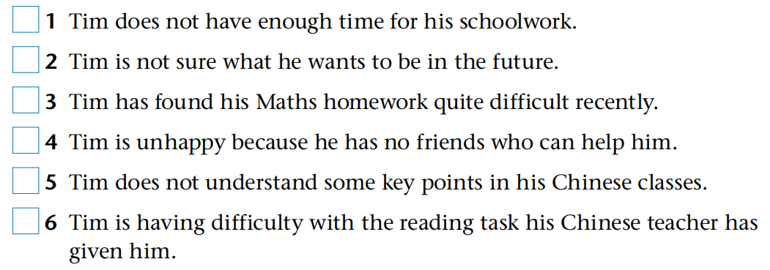
Task 1 Listen and tick
but

Slide 4
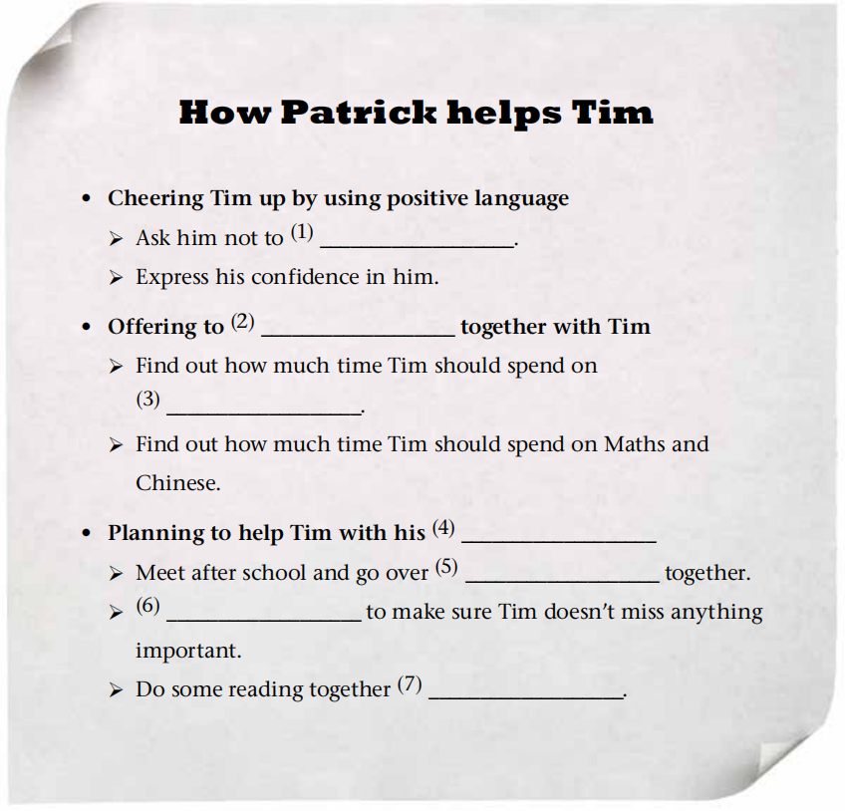
Task 2 Listen and complete
worry
make a timetable
his project
schoolwork
the challenging parts
Compare notes
at the weekend

Slide 5
Task 3 Read and find out the structure
What makes a good friend?
Para. 1: Introduction
Qualities
Para. 2
Be supportive
Para. 4
Be able to bring out the best in a person
Para. 3
Be selfless

Slide 6
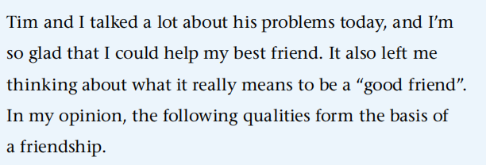
Task 4 Read and answer
1. How did the author introduce the topic?
By offering a personal experience.

Slide 7
Task 4 Read and answer
2. What are the topic sentences of each paragraph?
A good friend needs to be supportive. (Para. 2)
A good friend also needs to be selfless. (Para. 3)
To me, a good friend brings out the best in a person. (Para. 4)

Slide 8
Task 4 Read and answer
3. How did the author support his topic sentences in the passage?
By giving facts and examples, that is, the story between him and his best friend Tim.
4. What is the purpose of writing the passage?
The purpose is to show Patrick’s view about the
basic qualities of a good friend.

Slide 9
Task 4 Read and answer
5. What is the genre of the passage?
It is a diary entry.
In your diary, you can describe what you have observed and sound your thoughts about things that happened in life. You can be totally honest with yourself and speak with ease. You can simply note down anything you want with words.

Slide 10
Para. 1: Introduce by offering a personal experience
Para. 4
Be able to bring out the best in a person
Para. 2
Be supportive
Para. 3
Be selfless
Structure
Support the opinion by giving facts and examples

Slide 11
Task 5 Think and say
considerate
forgiving
Other qualities that make a good friend
kind-hearted
generous
optimistic
helpful
…

Slide 12
Task 6 Find and share
In groups, circle some useful expressions that describe friendship and qualities of a friend. You can also find more expressions by referring to the dictionary. Then please share them within your group and with other groups.

Slide 13
Task 6 Find and share
In my opinion, the following qualities form the basis of a friendship.
A good friend needs to be supportive.
To me, a good friend brings out the best in a person.
It’ll take up some of my spare time, but this friendship is worth my extra time and effort. I’m sure that Tim would do the same for me.
I’ll always value these qualities of a good friend and try to measure myself by these standards as our friendship develops.
True friendship is like sound health, the value of it is seldom known until it be lost.
A friend in need is a friend indeed.
A friend is a second self.
Your friend is the man who knows all about you and still likes you.
A friend without fault will never be found.
Fire is the test of gold, adversity of friendship.
Friendship is one soul in two bodies.

Slide 14
Homework
Find out more words for the qualities of a friend.
Write down a few stories between you and your friends. Share them with your partners.

Slide 15


