Slide 1

Unit 1 Back to school
Welcome to the unit & Reading (I)

Slide 2

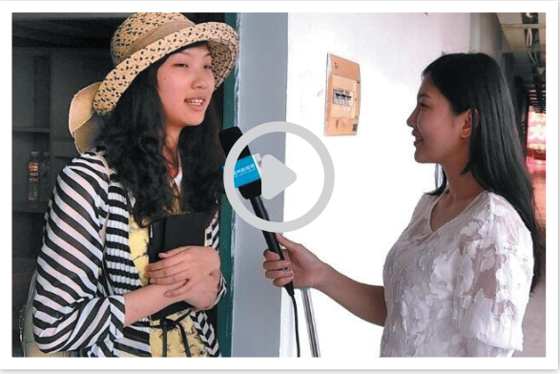
Watch a video

Slide 3
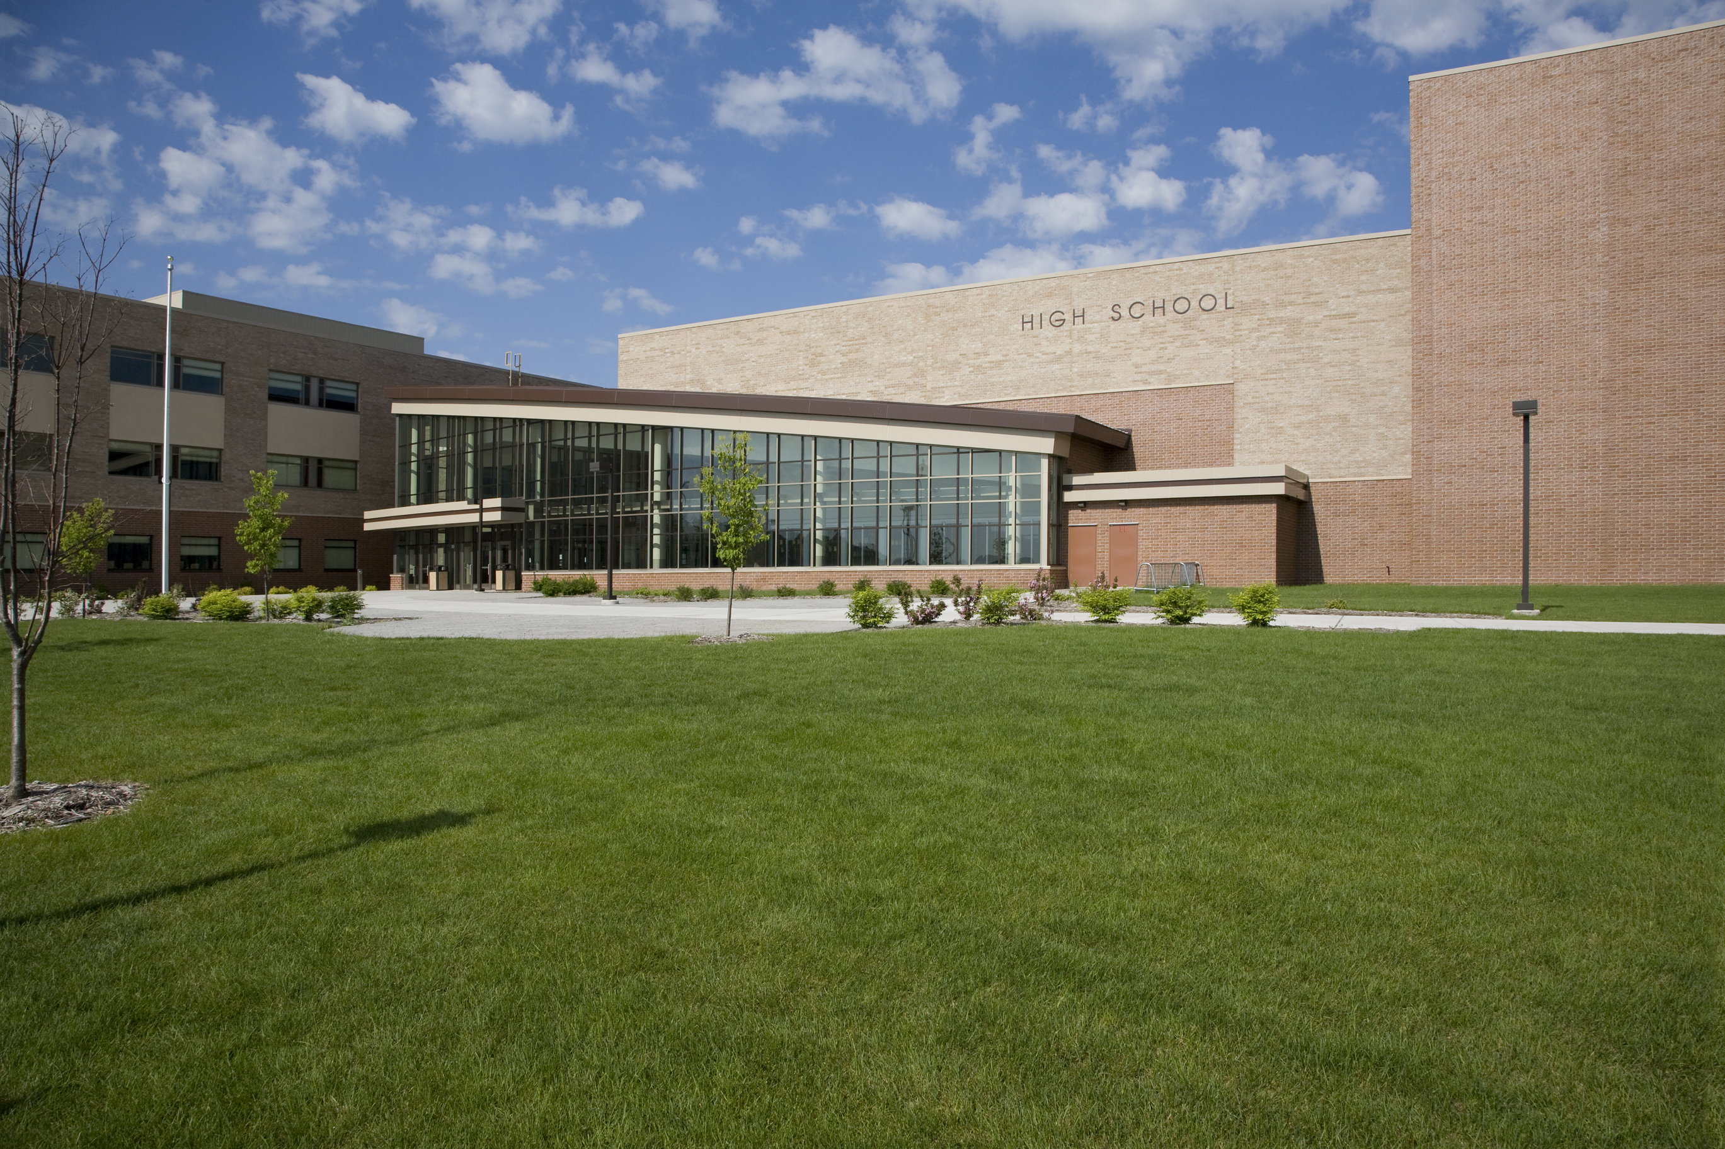
What is your impression of senior high school life?

Slide 4

A principal’s speech transcript
Realizing your potential

Slide 5
Understanding the idea of the speech

Slide 6
A1 Read the speech transcript and find the topic sentence for each paragraph.
Para. 1 | Welcome to senior high school!
Para. 2
Para. 3
Para. 4
Para. 5
Para. 6
I can’t wait to describe to you what senior high school life is like.
Put simply, potential is your natural ability that can be developed when you try hard enough.
To fully realize your potential, it is important for you to make the most of our school resources.
Of equal importance are good study habits, useful skills and a positive attitude.
You alone are responsible for realizing your great potential.

Slide 7
A1 Read the speech transcript and find the topic sentence for each paragraph.
Para. 1 | Welcome to senior high school!
Para. 2
Para. 3
Para. 4
Para. 5
Para. 6
Welcome of students’ arrival
I can’t wait to describe to you what senior high school life is like.
Description of school life
Put simply, potential is your natural ability that can be developed when you try hard enough.
Definition of potential
Advice on realizing potential
To fully realize your potential, it is important for you to make the most of our school resources.
Of equal importance are good study habits, useful skills and a positive attitude.
Advice on realizing potential
Expectation of students
Be confident, do your best and make us proud.

Slide 8
Challenges
Opportunities
a new
environment
new
knowledge
new ways
of thinking

Slide 9
Challenges
Opportunities
a new
environment
personal growth
great
knowledge
new
knowledge
new ways
of thinking

Slide 10

No challenge, no opportunity.
Turn your challenges into opportunities.
Challenges and opportunities coexist in the world.
Where there is a challenge, there is an opportunity.
Face the challenge bravely, hold the opportunity tightly, and adjust your state of mind, success is right at the corner!

Slide 11
Can potential be developed when you try hard enough?
The principal’s understanding?
Your understanding?
Definition of potential
The principal’s
examples?
Your potential?

Slide 12
External factors
Internal factors
School resources:
___ classes
___ teachers & classmates
___ school facilities
___ school activities
Good study habits:
_____ your study
_____ goals
_____ schoolwork with other activities
Advice on
realizing potential
Useful skills:
_____ skills
_____ skills
A positive attitude:
look on the _____
never lose ______

Slide 13
Understanding
the structure of the speech

Slide 14
The structure of a paragraph:
TS-SS-SS-SS-CS
good study habits,
useful
Of equal importance are good study habits, useful skills and a positive attitude. Carefully plan your study, set clear goals and balance your schoolwork with other activities. As a senior high school student, you must make efforts to improve your communication and problem-solving skills. Last but not least, always look on the bright side and never lose hope, even in difficult situations. n time you will find yourself growing into a well-round individual.
skills
and a positive attitude
In time

Slide 15
The link between paragraphs
To fully realize your potential, it is important for you to make the most of our school resources. Take advantage of your classes, learn from your teachers and classmates, and make use of our school facilities. There are also a lot of school activities for you. Join a club or two, and take an active part in different sports.
Of equal importance are good study habits, useful skills and a positive attitude. Carefully plan your study, set clear goals and balance your schoolwork with other activities. As a senior high school student, you must make efforts to improve your communication and problem-solving skills. Last but not least, always look on the bright side and never lose hope, even in difficult situations. In time you will find yourself growing into a well-round individual.

Slide 16
The structure of the speech
Para. 1 | Welcome to senior high school!
Para. 2
Para. 3
Para. 4
Para. 5
Para. 6
Welcome of students’ arrival
I can’t wait to describe to you what senior high school life is like.
Description of school life
Put simply, potential is your natural ability that can be developed when you try hard enough.
Definition of potential
Advice on realizing potential
To fully realize your potential, it is important for you to make the most of our school resources.
Of equal importance are good study habits, useful skills and a positive attitude.
Advice on realizing potential
Expectation of students
Be confident, do your best and make us proud.

Slide 17
The structure of the speech
Para. 1 | Welcome to senior high school!
Para. 2
Para. 3
Para. 4
Para. 5
Para. 6
Introduction (attractive)
Welcome of students’ arrival
I can’t wait to describe to you what senior high school life is like.
Body (clear &convincing)
Description of school life
Put simply, potential is your natural ability that can be developed when you try hard enough.
Definition of potential
Advice on realizing potential
To fully realize your potential, it is important for you to make the most of our school resources.
Of equal importance are good study habits, useful skills and a positive attitude.
Advice on realizing potential
Conclusion (impressive)
Expectation of students
Be confident, do your best and make us proud.

Slide 18
Understanding the language style
of the speech

Slide 19
A3 What techniques does the principal use?
Para. 1: Today is the start of a new term, the start of a three-year journey and the start of a promising future.
parallelism
Para. 2: Most importantly, your time and effort at senior high school will open the door to your potential.
metaphor
Para. 3: “ What is potential?” you may ask.
asking questions
Para. 6. As Lao-Tzu wisely said, “ A journey of a thousand miles begins with a single step.”
quotation

Slide 20

Telling stories
Giving examples
Being humorous
Using statistics

Slide 21
Understanding the purpose of the speech

Slide 22

To guide
To encourage
To inspire
To motivate

Slide 23
In-depth analysis of the speech

Slide 24
Rewrite and polish paragraph 2
What
Potential
Why?
How

Slide 25
Discussion
Knowledge
Qualities
students should have
Skills
Attitudes
Values

Slide 26
“I have a dream” Martin Luther King
Invention
Disposition
Style
Memory
Delivery
觅材取材
TED
谋篇布局
Jack Ma
语言风格
记忆内化
Steve Jobs
演讲表达
Inaugural speech就职演讲

Slide 27
Homework
Write a short speech of how you would like to spend your high school years.

Slide 28


